Slide 1
Town of Ulysses
Water Source Protection Plan Committee
Advisory Committee to Town Board
Public Water Survey 2023
Chair: Linda Liddle
Co-Chair: Roxanne Marino
Committee Members
Stephen Morreale
Tim Martinson
Amy Panek
Rebecca Schneider
Elizabeth Thomas
Town Board Liaison: Michael Boggs
Technical Consultants:
M. Theresa Julien, NY Rural Water Assoc.
Becky Simms, RCAP Solutions
1

Slide 2
Vision
The Town of Ulysses commits to protecting the quantity and quality of drinking water resources used by its residents, businesses, and landowners by identifying and implementing effective protection measures, engaging community support, and pursuing resources to access adequate potable water.
2

Slide 3
Broad Committee Goals
Develop a Drinking Water Source Protection Plan (DWSP2) to balance the protection, use, and sustainable development of drinking water supplies for the Town of Ulysses.
Engage town residents to gather relevant information concerning their water use and needs
3

Slide 4
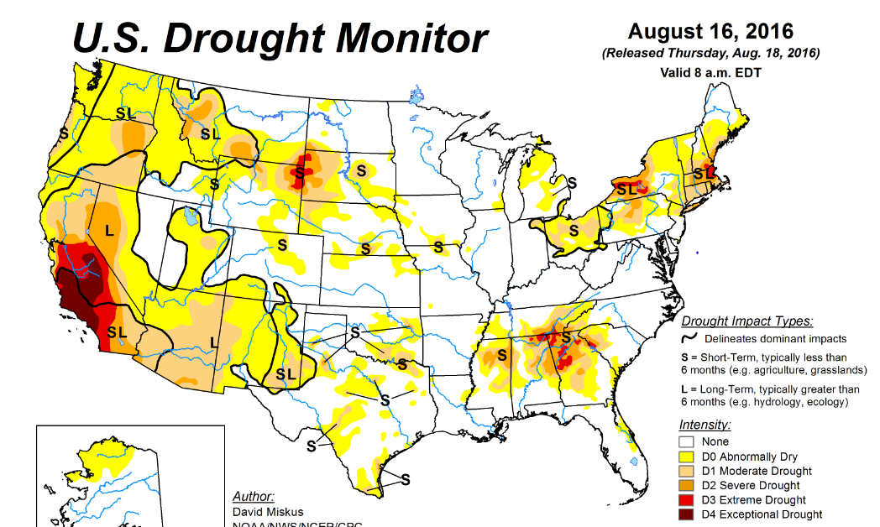
Importance of water protection in a changing world!
Increasing water scarcity due to droughts …
4

Slide 5
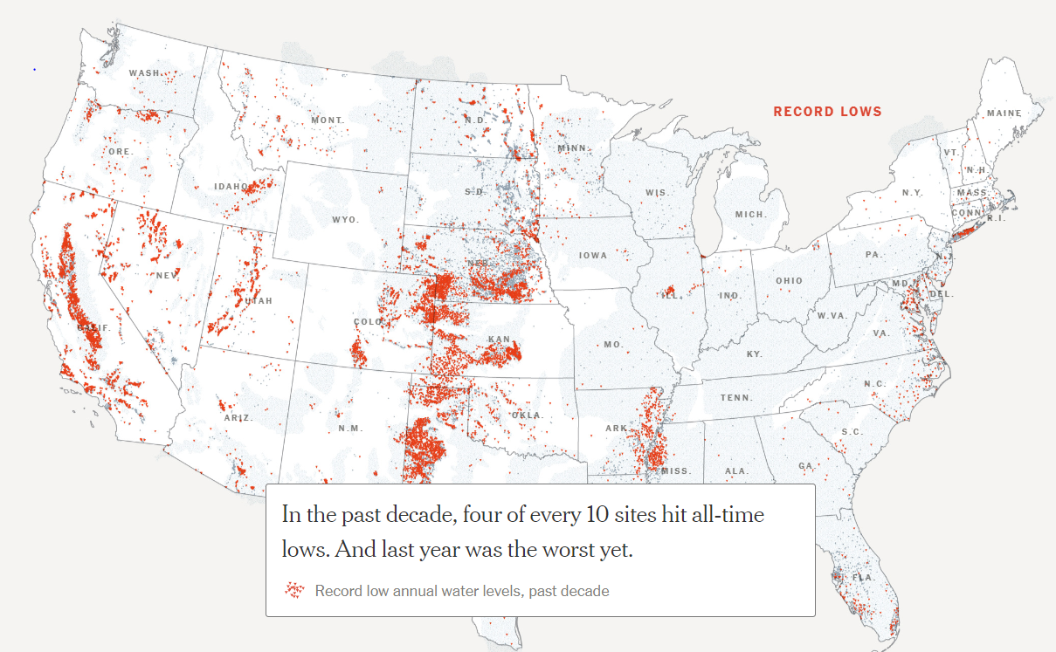
Importance of water protection in a changing world!
… or through overuse and mis-management
Aquifer depletion – NY Times Sept2023
5

Slide 6
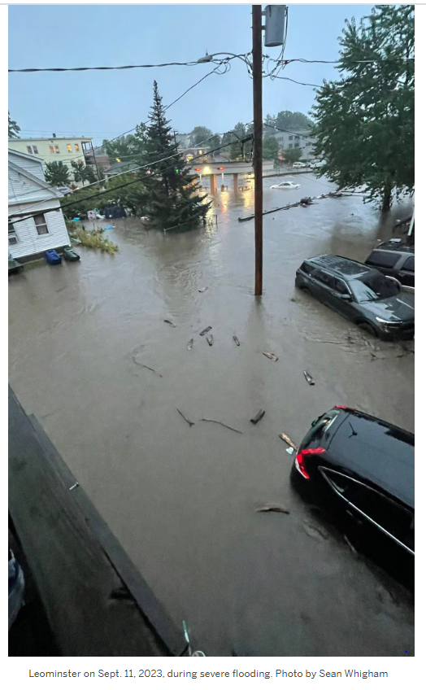
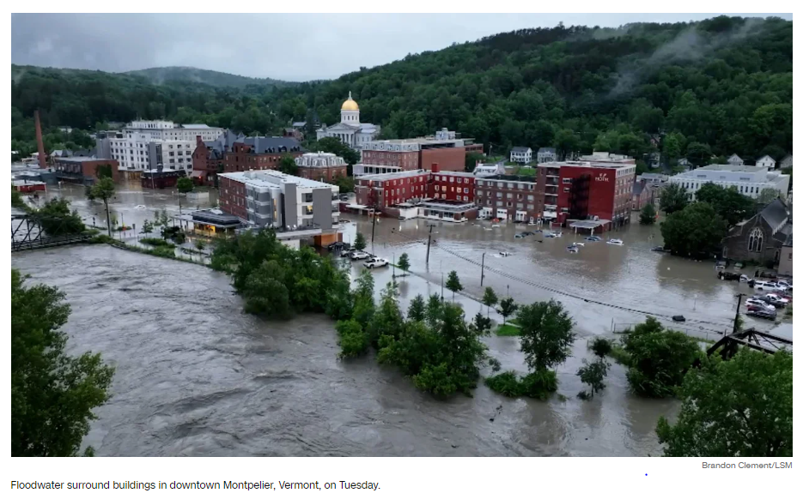
Importance of water protection in a changing world!
Increasing frequency and magnitude
of torrential storms
September 11, 2023
Leominster, MA
11 in rain
July 10, 2023 Montpelier, VT - 12 in rain
6

Slide 7
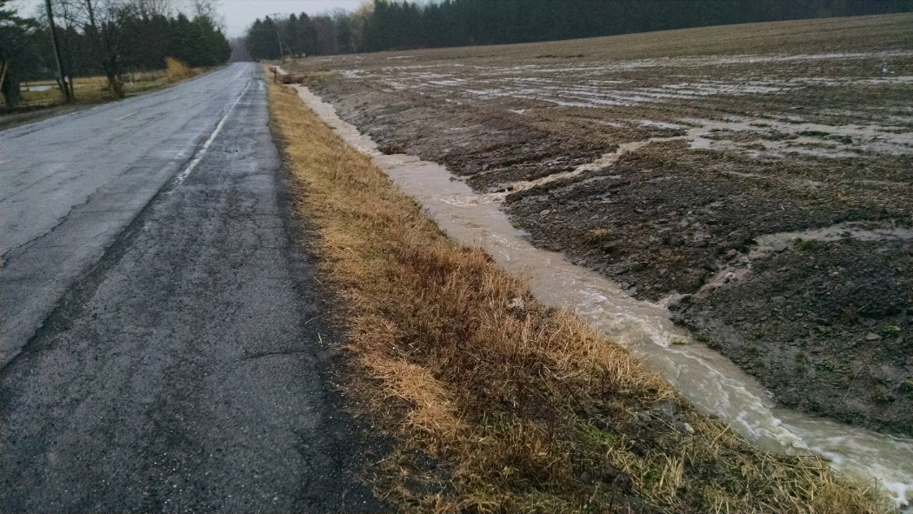
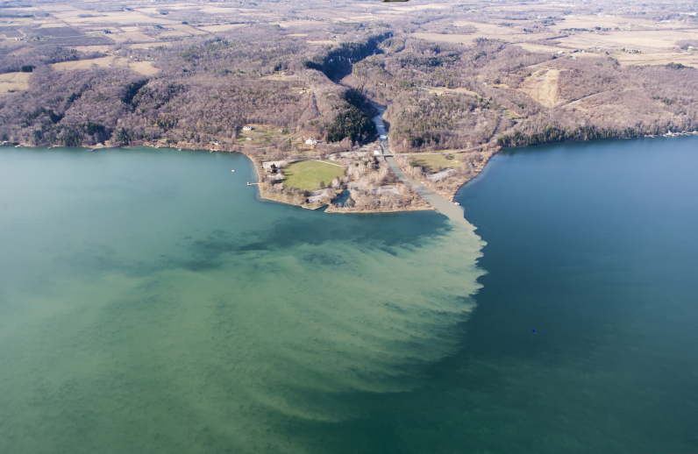
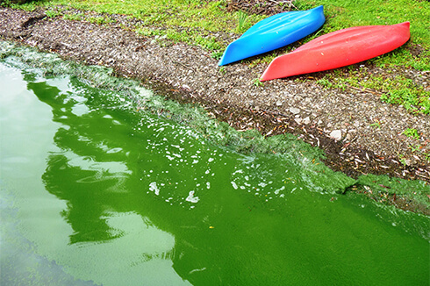
Importance of water protection in a changing world!
Combined with poor land use management
can lead to pollution
Bill Hecht
7

Slide 8
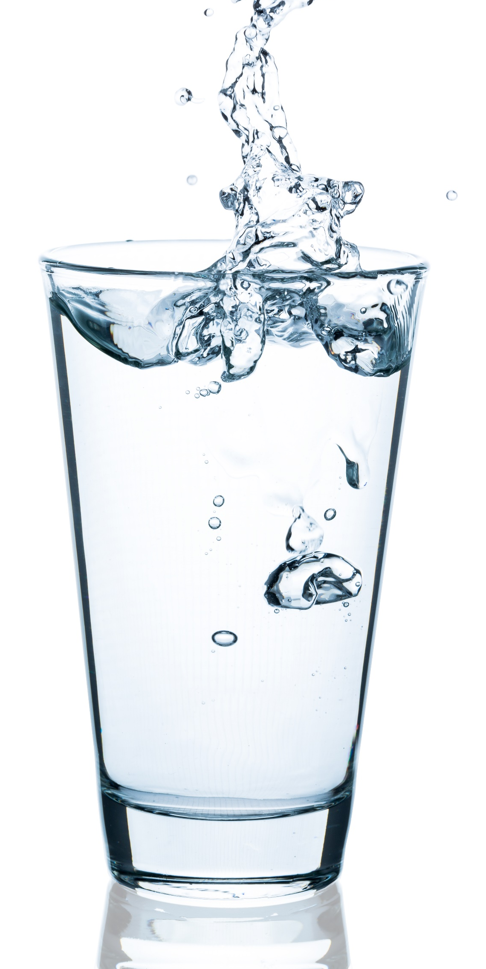
The Ulysses Water Committee has been charged by the Ulysses Town Board to develop a proactive plan for protecting our drinking water supplies.
SPECIFIC GOALS:
Inventory and assess drinking water sources and resources in Ulysses; engage stakeholders
Identify potential and existing issues and/or threats to source water;
Work to protect sensitive source water contribution
areas from contamination by identifying and
implementing protection and management methods;
Designate a plan management team to oversee the implementation of the plan.
OUTREACH TO STAKEHOLDERS
Collect Information Find Solutions Implement Plan
See website for 8 specific goals and details
8

Slide 9
To engage Ulysses Residents and inventory their drinking water quality and quantity concerns, the Ulysses Water Committee is conducting a
Survey of Town Residents
In October 2023:
Simple, 2 pg survey
Survey information will be in the Town’s weekly e-Newsletter
Online version of survey (RCAP), and a paper version will also be available to Town residents (outside the Village)
Survey data will be collected through the fall.
9

Slide 10
What information is needed?
Where do you get your water from?
If a well, do you have any concerns about
quantity or quality?
What is the address for the data so we
can evaluate local patterns that help to
identify appropriate solutions?
(only summary data shared – individual
privacy protected)
10

Slide 11
Stay tuned!
After the Survey is complete, the Ulysses Water Committee, working collaboratively with the New York Rural Water Association, will host an Educational Community Workshop about Source Water Protection in Ulysses
A summary of the Survey Data will be available
Resources provided for home water well testing.
Presenters will speak about water protection.
11

Slide 12
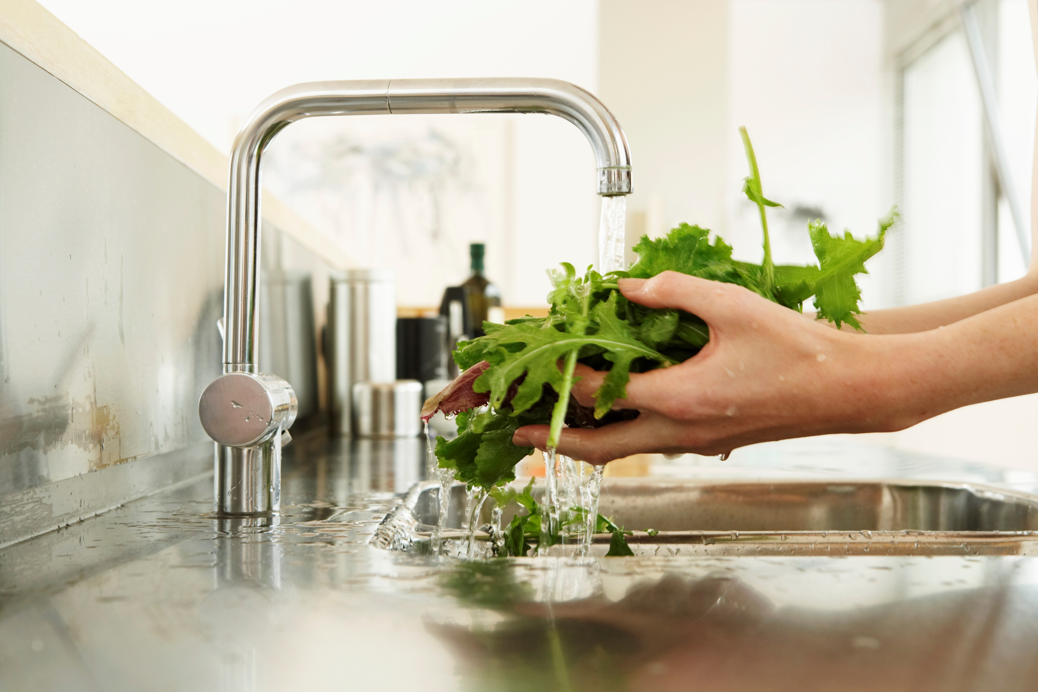
What happens then?
Survey results will be integrated with additional information, such as potential threats to aquifers, streams and lake waters
Survey results will be compared with 2009 Ulysses Water Survey
A Source Water Protection Plan and Generalized Map of Sources and Threats will be drafted and reviewed by the Town Board
There will be mechanisms for public comment
and input.
Once finalized and approved, a plan
management team
will oversee implementation.
12

Slide 13
Thank you!
It takes a Town to protect our future!
For more information,
check out the Ulysses Water Committee Website
https://www.townofulyssesny.gov/boards/wsppc-source-water-protection-committee/
13

